Slide 1
Benchmarking in Communication Network for Distribution Power System -Case Study USM Campus
Jesus Eduardo Ortiz Sandoval
PhD Student

Slide 2
Previous work
{1} M. A. Ahmed and Young-Chon Kim, “System Architecture based on IoT for Smart Campus Parking Lots” International conference on Computer Applications & Information Security, ICCAIS'2019. 01-03 May, 2019.

Slide 3
Problem
It’s more efficiently star topology with fiber that Bus with splitter (EPCON), in the latency measurement.

Slide 4
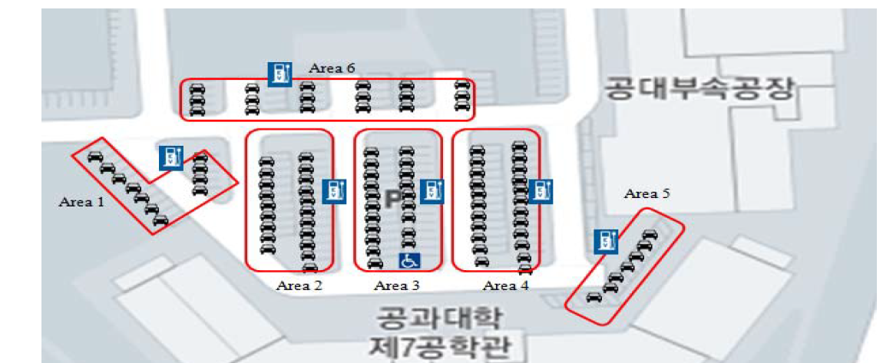
Chonbuk National University, South Korea {1}

Slide 5
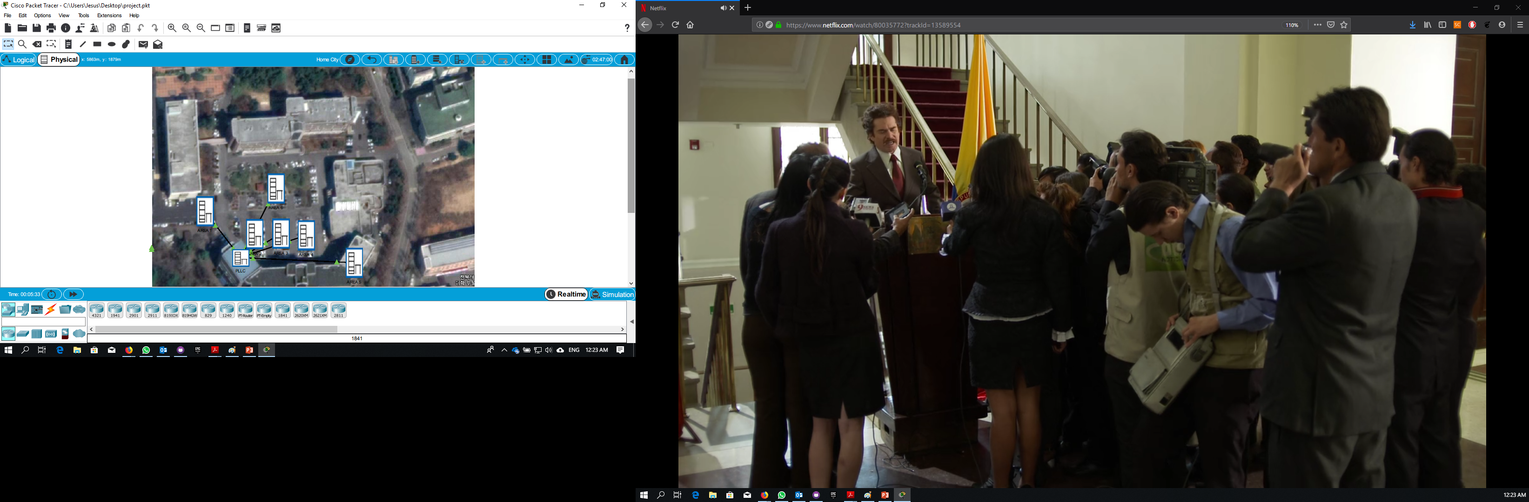
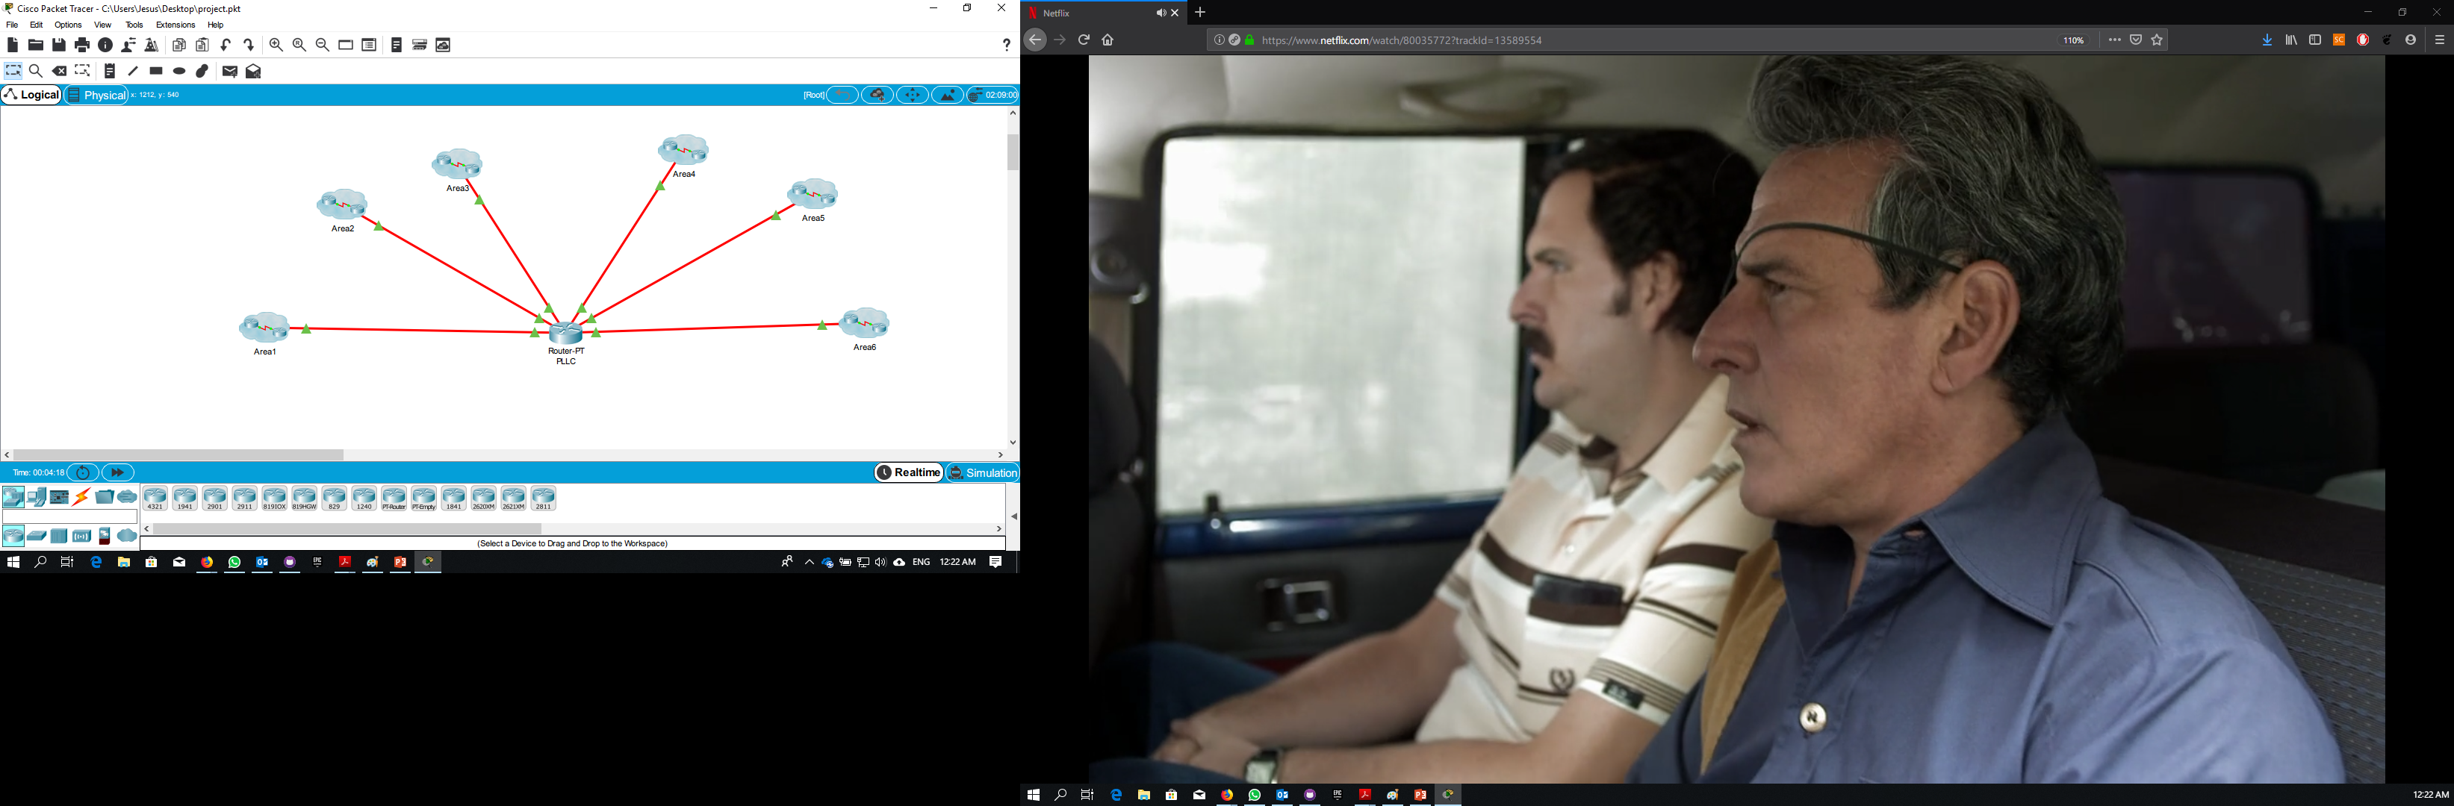
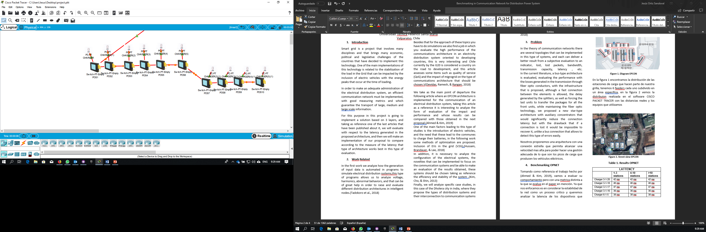

Slide 6
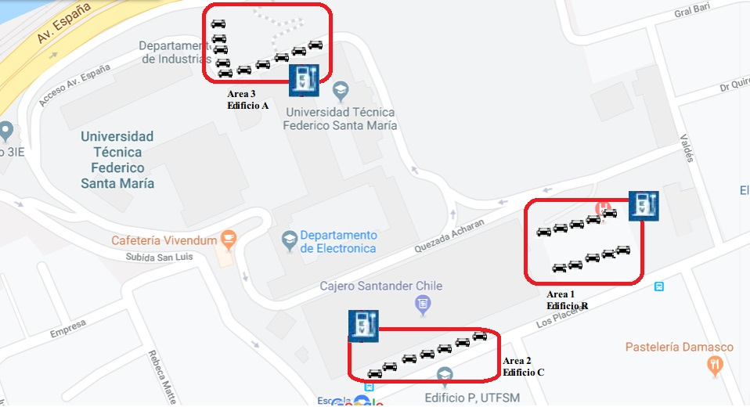
USM CAMPUS (PROPOSAL)

Slide 7
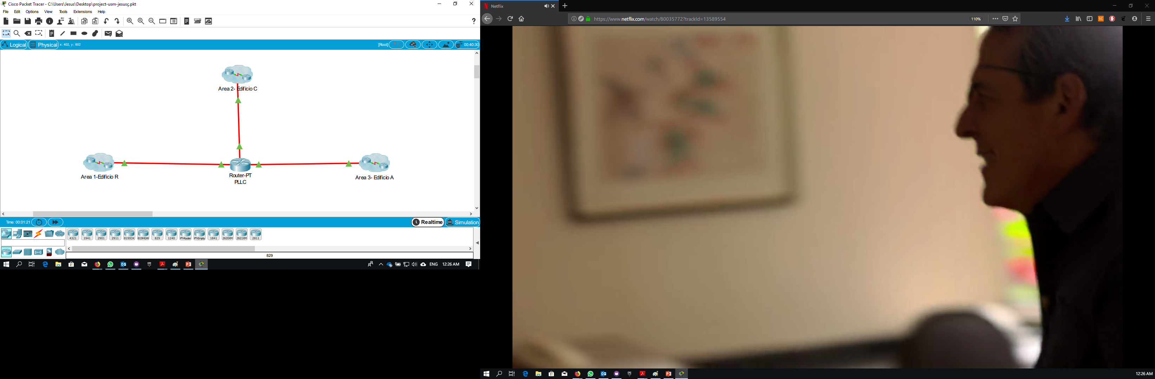
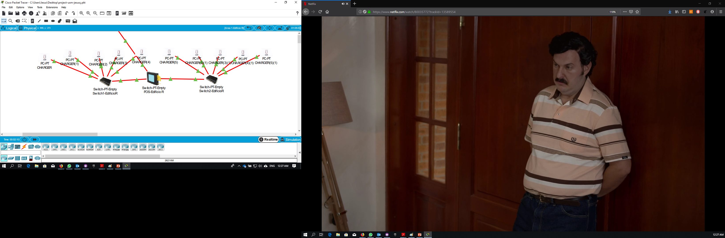

Slide 8
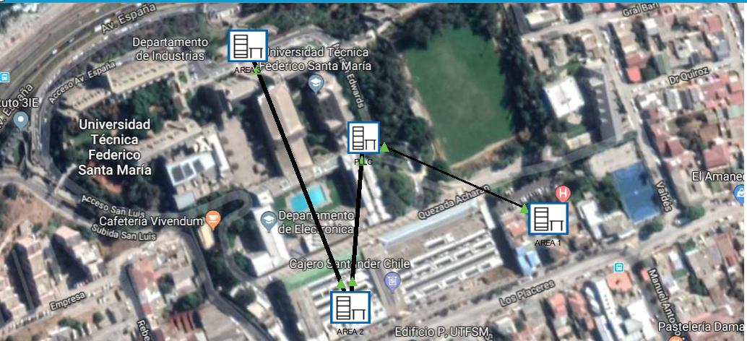

Slide 9
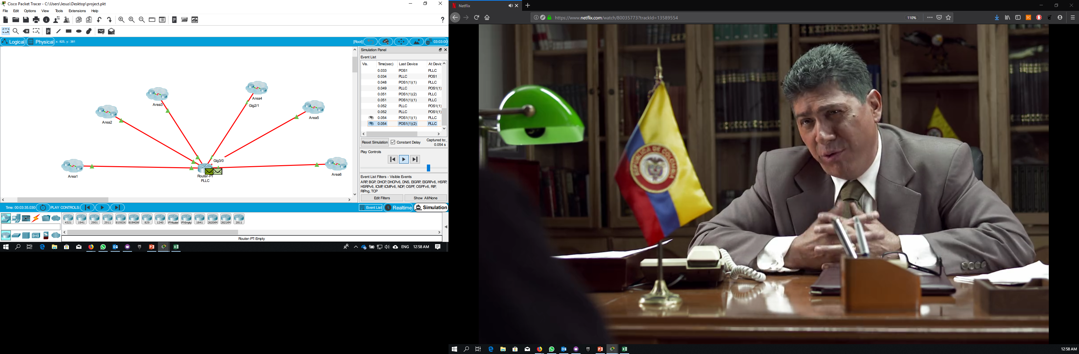
Results Original Paper
LATTENCY
 | 1-3 stations | 4-10 stations | >10 stations
Charger 3-1-20 | 42 ms | 42 ms | 42 ms
Charger 3-1-18 | 40 ms | 40 ms | 40 ms
Charger 3-1-17 | 47 ms | 47 ms | 47 ms
Charger 3-1-16 | 36 ms | 36 ms | 36 ms
Charger 6-1-5 | 38 ms | 38 ms | 38 ms
Charger 5-1 | 22 ms | 22 ms | 22 ms
Charger 6-1-15 | 36ms | 36ms | 36ms
Charger 4-1-7 | 34 ms | 34 ms | 34 ms

Slide 10
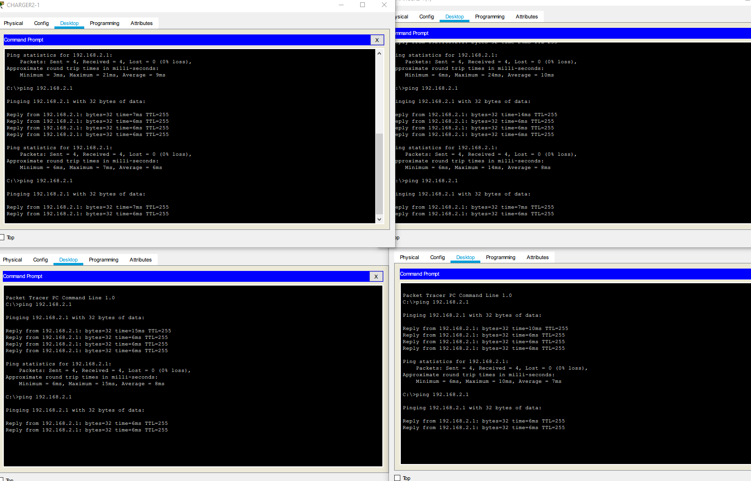
Results USM Case Study
LATTENCY
 | 1-3 stations | 4-10 stations | >10 stations
Charger 2 | 4 ms | 6 ms | 7 ms
Charger 3 | 4 ms | 6 ms | 7 ms
Charger 4 | 4 ms | 6 ms | 7 ms
Charger 5 | 4 ms | 6 ms | 7 ms
Charger 6 | 4 ms | 6 ms | 7 ms
Charger 7 | 4 ms | 6 ms | 7 ms
Charger 8 | 4 ms | 6 ms | 7 ms
Charger 9 | 4 ms | 6 ms | 7 ms
Charger 10 | 4 ms | 6 ms | 7 ms
Charger 11 | 4 ms | 6 ms | 7 ms
Charger 12 | 4 ms | 6 ms | 7 ms
Charger 13 | 4 ms | 6 ms | 7 ms
Charger 14 | 4 ms | 6 ms | 7 ms
Charger 15 | 4 ms | 6 ms | 7 ms
Charger 16 | 4 ms | 6 ms | 7 ms
Charger 17 | 4 ms | 6 ms | 7 ms
Charger 18 | 4 ms | 6 ms | 7 ms
Charger 19 | 4 ms | 6 ms | 7 ms

